Slide 1
Overview of Machine Learning
Geoff Hulten

Slide 2
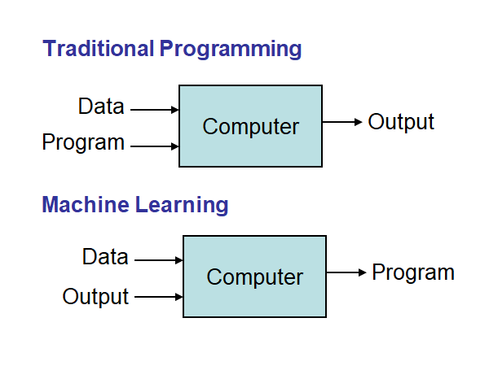
Definitions of Machine Learning
Machine learning is a branch of artificial intelligence based on the idea that systems can learn from data, identify patterns and make decisions with minimal human intervention.
A computer program that can learn from experience E with respect to some class of tasks T and performance measure P, so that its performance at tasks in T, as measured by P, improves with experience E.

Slide 3
Successes of Machine learning
Web search
Finance / Trading
Marketing
Fraud and Security
E-commerce
Robotics
‘Self Driving’ Cars
Health Care
Social networks
Recommendations
NLP / Digital Assistants
Kinect
Alpha Go
[Your favorite area]

Slide 4
Why Machine Learning
Why not ML?
Simple Problems
Deterministic Problems
Static Problems
Problems efficiently solved
Situations for ML:
Big problems
Open ended problems
Time changing problems
Intrinsically hard problems

Slide 5
Machine Learning Algorithms
Tens of thousands of machine learning algorithms, hundreds new every year
Types of Machine Learning Algorithms:
Supervised (inductive) learning Training data includes desired outputs
Unsupervised learning Training data does not include desired outputs
Semi-supervised learning Training data includes a few desired outputs
Reinforcement learning Rewards from sequence of actions

Slide 6
Components of a ML Solution
Training data
Context
Features
Labels
Training Examples
Training environment
Processing
Learning algorithms
Evaluation
Deployment
Models
Interacting with users
Observations & Telemetry
Orchestration
Adapting over time
Dealing with mistakes
Maintaining Balance

Slide 7
Components of a ML Algorithm
Model Structure (Representation)
Linear Models
Decision trees
Ensembles of models
Instance based methods
Neural networks
Support vector machines
Graphical models (Bayes/Markov nets)
Etc.
Loss Function (Evaluation)
Accuracy
Precision and recall
Squared error
Likelihood
Posterior probability
Cost / Utility
Margin
Entropy
K-L divergence
Etc.
Fitting Parameters (Optimization)
Greedy search
Gradient Descent
Linear Programming
Many variations

Slide 8
Brief Review of Data
Unstructured Data
Collection of e-books
Crawl of 1,000,000 web pages
The raw contents of your hard drive
Images of every product in a product catalogue
Structured Data
Numerical
Categorical
Binary
Text
Relational
Etc…
Book Title | Number of Pages | Year Published | Genre | Best Seller | HasWord(Robot) | Author ID
Gone With The Wind | 1037 | 1936 | Historical Romance | 1 | 0 | 1001
For Whom the Bell Tolls | 480 | 1940 | War Drama | 1 | 0 | 1010
I, Robot | 253 | 1980 | Science Fiction | 1 | 1 | 1020
One Hundred Goodbyes | 100 | 2018 | Science Fiction | 0 | 0 | 1030

Slide 9
Training Data – < x, f(x) >
Book Title | Number of Pages | Year Published | Genre | Best Seller | HasWord(Robot) | Author ID
Gone With The Wind | 1037 | 1936 | Historical Romance | 1 | 0 | 1001
For Whom the Bell Tolls | 480 | 1940 | War Drama | 1 | 0 | 1010
I, Robot | 253 | 1980 | Science Fiction | 1 | 1 | 1020
One Hundred Goodbyes | 100 | 2018 | Science Fiction | 0 | 0 | 1030

Slide 10
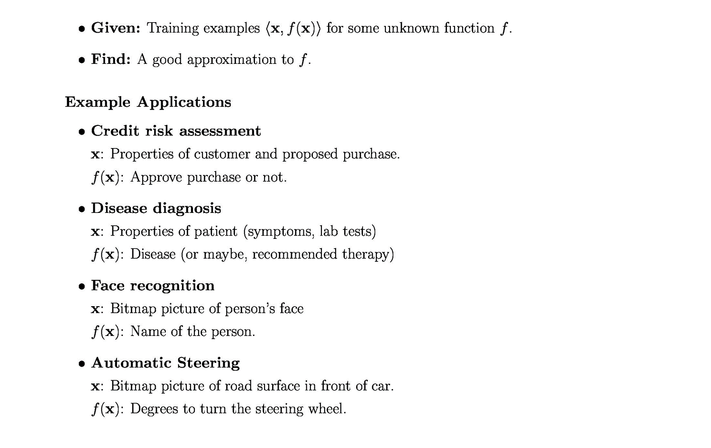
Supervised Learning
Types of Supervised Learning
Discrete F(X): Classification
Continuous F(X): Regression
F(X) = Probability(X): Probability estimation

Slide 11
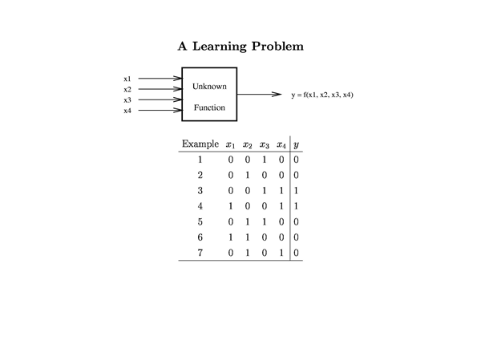
Learning a Simple Function
Possibilities for f(x):
X1
X1 ^ X2
~X1
X1 == X2
X1 != X2
X1 ^ !xor(x2, x3, x4)
…
There are 2^2^n Boolean functions on n Boolean variables.
2^2^4 = 65536

Slide 12
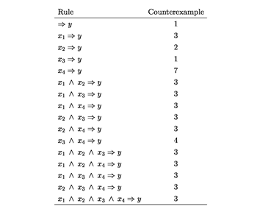
Hypothesis Space: Conjunctive Rules

Slide 13
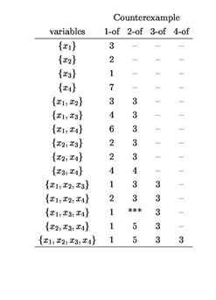
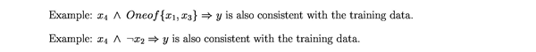
Hypothesis Space: m-of-n

Slide 14
ML In Practice
Roles in Machine Learning
Machine learning researcher
Machine learning practitioner
Data scientist
Machine learning engineer
Machine Learning Researcher
Develop new algorithms
Explore cutting edge problems
Advance human knowledge

Slide 15
ML In Practice
Roles in Machine Learning
Machine learning researcher
Machine learning practitioner
Data scientist
Machine learning engineer
Machine Learning Practitioner
Understanding domain, prior knowledge, and goals
Data integration, selection, cleaning, pre-processing, etc.
Build effective models
Interpret results
Iterate and iterate and iterate…

Slide 16
ML In Practice
Roles in Machine Learning
Machine learning researcher
Machine learning practitioner
Data scientist
Machine learning engineer
Data scientist
Organize, understand, & make data actionable
Answer questions from data
Lots of cross over with machine learning practitioner

Slide 17
ML In Practice
Roles in Machine Learning
Machine learning researcher
Machine learning practitioner
Data scientist
Machine learning engineer
Machine learning engineer
Integrate machine learning models into production systems
Connect machine learning with users
User experience
Telemetry
Implement Inference systems
Make everything work…

